Slide 1

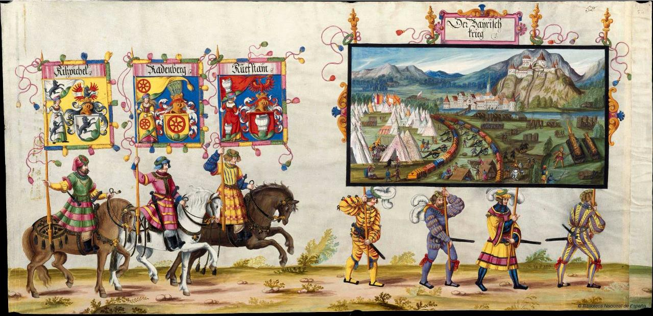

Coffee Break

Slide 2
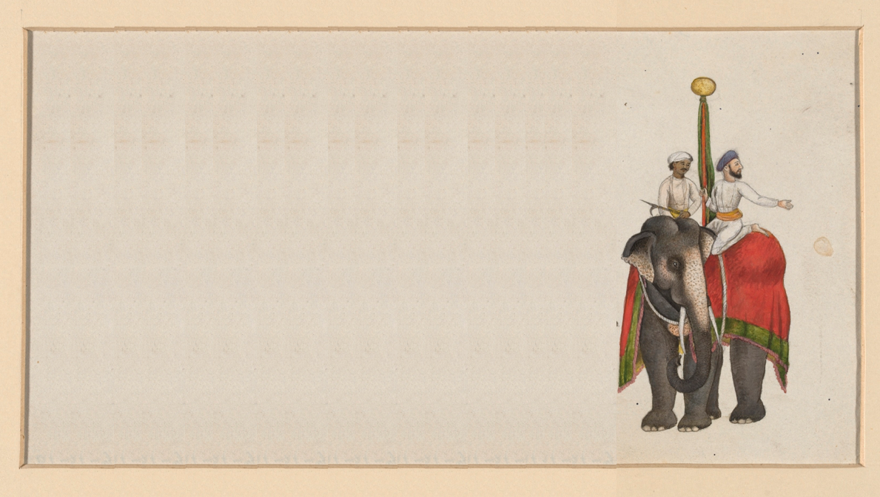
Reconvene
In the first half, we have seen many wonderful things you can do with the Matrix Profile, without explaining how to compute it!
In this half, we will describe algorithms to compute matrix profile, optimization techniques for scalability, portability to modern hardware, approximation to gain speed, and extension to special cases.
We embed MATLAB scripts in slides that can reproduce charts and numbers, and explain algorithms.
Slides are text heavy to facilitate offline readers. In the presentation, focus is on figures.
Let’s begin…

Slide 3

Outline
Act 1
Act 2
Our Fundamental Assumption
What is the (MP) Matrix Profile?
Properties of the MP
Developing a Visual Intuition for MP
Basic Algorithms
MP Motif Discovery
MP Time Series Chains
MP Anomaly Discovery
MP Joins (self and AB)
MP Semantic Segmentation
From Domain Agnostic to Domain Aware: The Annotation Vector (A simple way to use domain knowledge to adjust your results)
The “Matrix Profile and ten lines of code is all you need” philosophy.
Break
Background on time series mining
Similarity Measures
Normalization
Distance Profile
Brute Force Approach
Just-in-time Normalization
The MASS Algorithm
Extensions of MASS
Matrix Profile
STAMP
STOMP
GPU-STOMP
SCRIMP
Open problems to solve

Slide 4
What are Time Series? 1 of 2
A time series is a collection of observations made sequentially in time.
More than most types of data, time series lend themselves to visual inspection and intuitions…
29
25.350
25.350
25.400
25.400
25.325
25.225
25.200
25.175
..
24.625
24.675
24.675
24.675
For example, looking at the numbers in this blue vector tells us nothing.
But after plotting the data, we can recognize a heartbeat, and possibly even diagnose this person's disease.
When the observations are uniformly sampled, the index of observation can replace the time of observation. In the rest of the tutorial, we assume time series are vectors.
The observations may have a unit.
28
27
Electric Potential
26
25
24
23
0
100
200
300
400
500

Slide 5

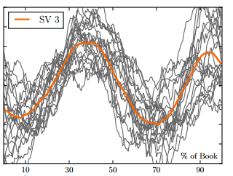
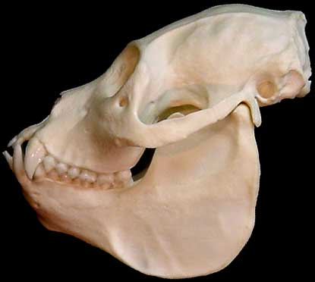
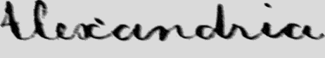
What are Time Series? 2 of 2
As an aside… (not the main point for today)
Many types of data that are not true time series can be fruitfully transformed into time series, including DNA, speech, textures, core samples, ASCII text, historical handwriting, novels and even shapes.
Mantled Howler Monkey
Alouatta palliata
0
50
100
150
200
250
300
350
400
450

Slide 6
Similarity Measures for Time Series
A similarity measure compares two time series and produces a number representing their similarity
A distance measure is the opposite of similarity measure
Lockstep Measures
Euclidean Distance
Correlation Coefficient
Cosine Similarity
Elastic Measures
Dynamic Time Warping
Edit Distance
Longest Common Subsequence

Slide 7
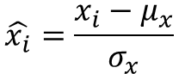
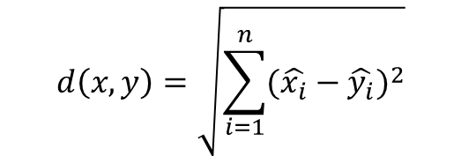
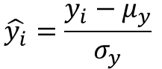
Euclidean Distance Metric
Given two time series
x = x₁…x_{n}
and
y = y₁…y_{n}
their z-Normalized Euclidean distance is defined as:
x
y
$$\hat{x_{i}}=\frac{x_{i}−μ_{x}}{σ_{x}}$$
$$\hat{y_{i}}=\frac{y_{i}−μ_{y}}{σ_{y}}$$
3
function y = zNorm(x)
y = (x-mean(x))/std(x,1);
2
1
0
$$d\left(x,y\right)=\sqrt{\sum_{i=1}^{n}{{(\hat{x_{i}}−\hat{y_{i}})}^{2}}}$$
-1
-2
0
100
200
300
400
500
600
700
800
900
1000
function d = EuclideanDistance(x,y)
d = sqrt(sum((x-y).^2));

Slide 8
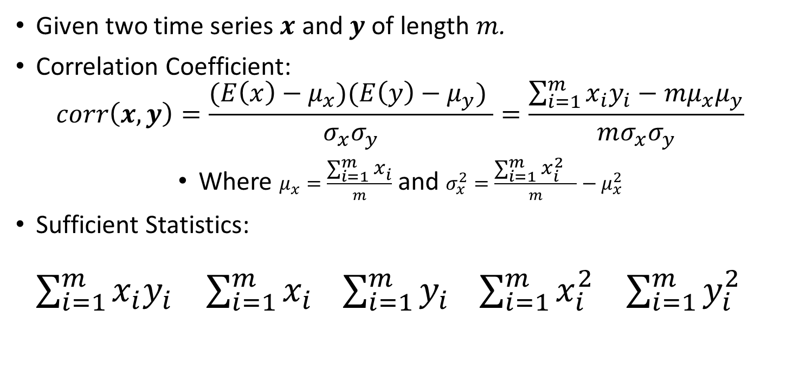
Pearson’s Correlation Coefficient
Given two time series $x$ and $y$ of length $m$.
Correlation Coefficient:
$$corr\left(x,y\right)=\frac{(E\left(x\right)−μ_{x})(E\left(y\right)−μ_{y}) }{σ_{x}σ_{y}}=\frac{\sum_{i=1}^{m}{x_{i}y_{i}−mμ_{x}μ_{y}}}{mσ_{x}σ_{y}}$$
Where $μ_{x}=\frac{\sum_{i=1}^{m}{x_{i}}}{m}$ and $σ_{x}^{2}=\frac{\sum_{i=1}^{m}{x_{i}^{2} }}{m}−μ_{x}^{2}$
Sufficient Statistics: $\sum_{i=1}^{m}{x_{i}y_{i}}$ $\sum_{i=1}^{m}{x_{i}} \sum_{i=1}^{m}{y_{i}} \sum_{i=1}^{m}{x_{i}^{2} }$ $\sum_{i=1}^{m}{y_{i}^{2}}$
The sufficient statistics can be calculated in one linear scan. Given the sufficient statistics, correlation coefficient is a constant operation. Note the use of the dot product, which is the key component of many lockstep measures.

Slide 9
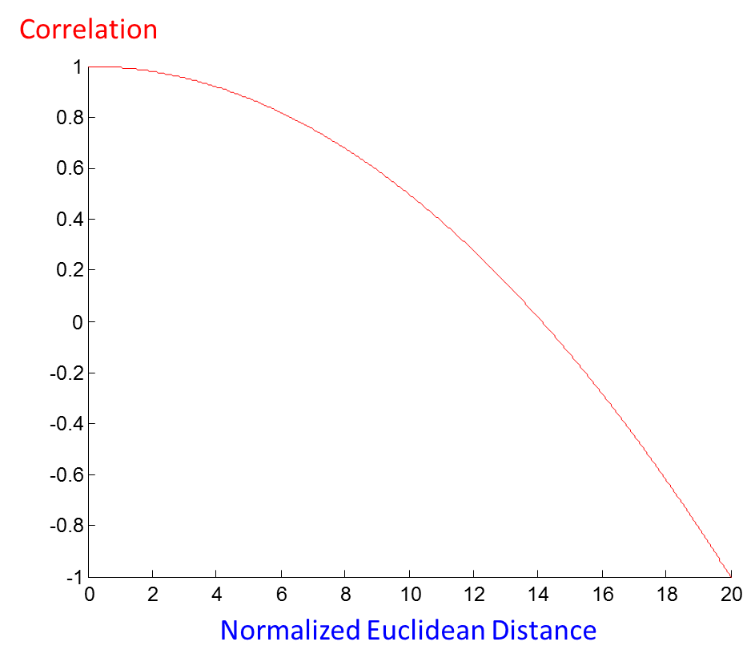
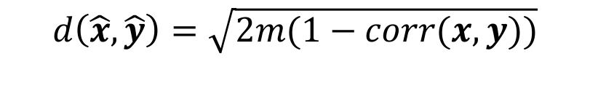
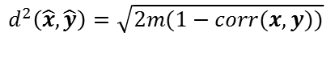
Relationship with Euclidean Distance
$$d\left(\hat{x},\hat{y}\right)=\sqrt{2m(1−corr(x,y))}$$
Correlation coefficient does not obey triangular inequality, while Euclidean distance does
Maximizing correlation coefficient can be achieved by minimizing normalized Euclidean distance and vice versa
Correlation coefficient is bounded between -1 and 1, while z-normalized Euclidean distance is bounded between zero and a positive number dependent on m
20 for m = 100
Abdullah Mueen, Suman Nath, Jie Liu: Fast approximate correlation for massive time-series data. SIGMOD Conference 2010: 171-182
$$d^{2}\left(\hat{x},\hat{y}\right)=\sqrt{2m(1−corr(x,y))}$$

Slide 10
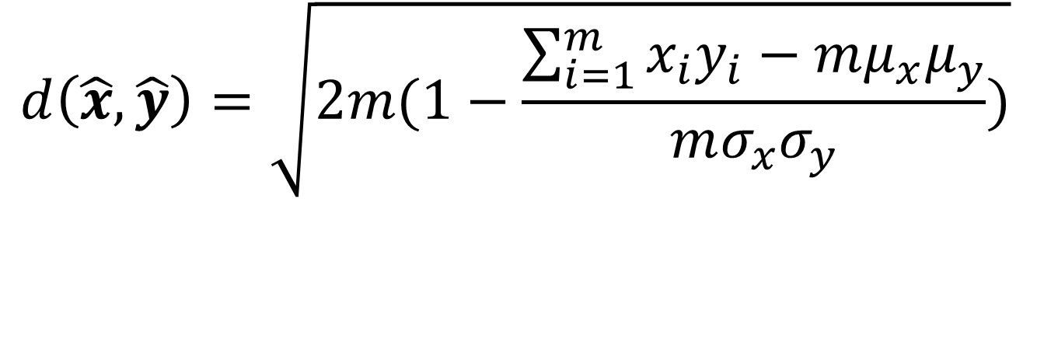
Working Formula
$$d\left(\hat{x},\hat{y}\right)=\sqrt{2m(1−\frac{\sum_{i=1}^{m}{x_{i}y_{i}−mμ_{x}μ_{y}}}{mσ_{x}σ_{y}})}$$
We will use the above z-Normalized Euclidean distance as the similarity measure for the rest of the presentation
We claim calculating Matrix Profile for Correlation Coefficient and Cosine Similarity is trivial given an algorithm for z-Normalized Euclidean distance

Slide 11
The Importance of z-Normalization and correlation 1 of 2
Essentially all datasets must have every subsequence z-normalized.
There are a handful of occasions where it does not make sense to z-normalize, but in those cases, similarity search does not make sense either.
In this example, we begin by extracting heartbeats from two unrelated people.
Even without normalization, it happens that both sets have almost the same mean and standard deviation. Given that, do we need to bother to normalize them? (next slide)
BIDMC Congestive Heart Failure Database: chf11
1
0
-1
-2
BIDMC Congestive Heart Failure Database: chf10
-3
0
1000
Extracted beats
chf10
chf11
0
150
300

Slide 12
The Importance of z-Normalization and correlation 2 of 2
Without normalization, the results are very poor, some blue heartbeats are closer to red heartbeats than there are to another blue beat .
With normalization, the results are perfect.
BIDMC Congestive Heart Failure Database: chf11
1
0
-1
-2
BIDMC Congestive Heart Failure Database: chf10
-3
0
1000
Extracted beats
chf10
chf11
0
150
300
Un-normalized
Normalized
In this example, we extracted heartbeats from two different time series, and clustered them with and without normalization.
Surprisingly z-normalizing can be a computational bottleneck, but later we will show you how to fix that.

Slide 13
Outline
Act 1
Act 2
Our Fundamental Assumption
What is the (MP) Matrix Profile?
Properties of the MP
Developing a Visual Intuition for MP
Basic Algorithms
MP Motif Discovery
MP Time Series Chains
MP Anomaly Discovery
MP Joins (self and AB)
MP Semantic Segmentation
From Domain Agnostic to Domain Aware: The Annotation Vector (A simple way to use domain knowledge to adjust your results)
The “Matrix Profile and ten lines of code is all you need” philosophy.
Break
Background on time series mining
Similarity Measures
Normalization
Distance Profile
Brute Force Approach
Just-in-time Normalization
The MASS Algorithm
Extensions of MASS
Matrix Profile
STAMP
STOMP
GPU-STOMP
SCRIMP
Open problems to solve

Slide 14
Distance Profile
Sliding Window
Query
Compute the z-normalized Euclidean distance between Query and each window (subsequence) in the time series. We would obtain a vector like this:
d₁ | d₂ | … | d_{n-m+1}
D
d_{i} is the distance between the i^{th} subsequence and the query.
Recall, n is the length of the blue time series
and m is the length of the query

Slide 15
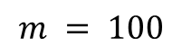
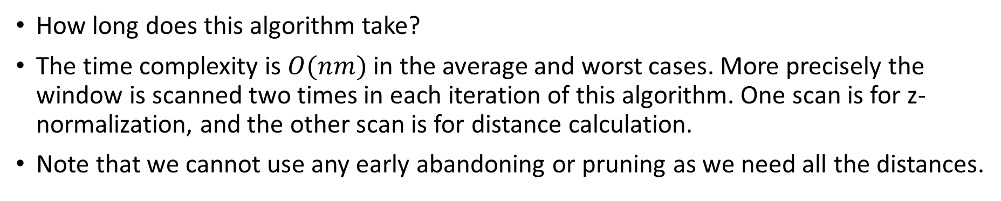
The Brute Force Algorithm
Almost an hour
Scan the time series with a sliding window
Z-Normalize the window
Calculate Euclidean distance between window and the query
2¹²
$$m = 100$$
2⁸
BF
2⁴
Seconds
2⁰
d(1:n) = 0;
Q = zNorm(query);
for i = 1:n-m+1
d(i) = sqrt(sum((zNorm(T(i:i+m-1))-Q).^2));
end
2⁻⁴
2⁻⁸
10⁵
10⁶
n
10⁷
10⁸
How long does this algorithm take?
The time complexity is $O(nm)$in the average and worst cases. More precisely the window is scanned two times in each iteration of this algorithm. One scan is for z-normalization, and the other scan is for distance calculation.
Note that we cannot use any early abandoning or pruning as we need all the distances.

Slide 16
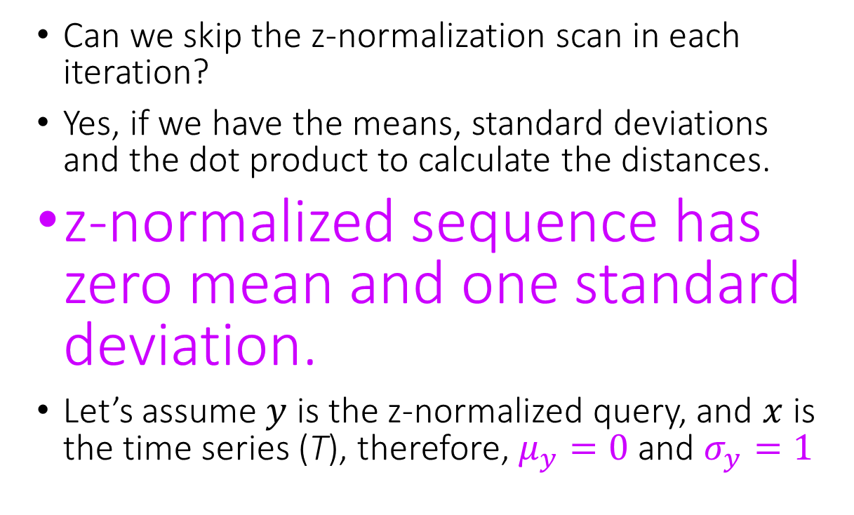
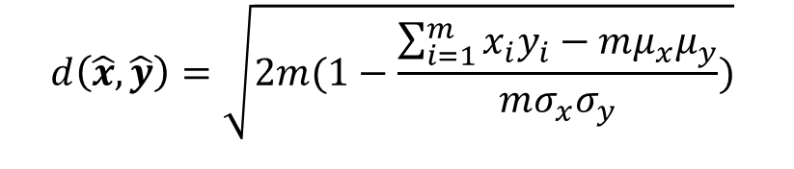
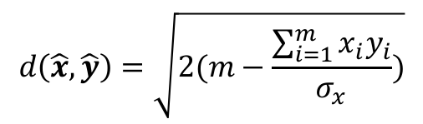
Just-in-time Normalization (1 of 3)
Can we skip the z-normalization scan in each iteration?
Yes, if we have the means, standard deviations and the dot product to calculate the distances.
z-normalized sequence has zero mean and one standard deviation.
Let’s assume $y$ is the z-normalized query, and $x$ is the time series (T), therefore, $μ_{y}=0$ and $σ_{y}=1$
Working Formula
$$d\left(\hat{x},\hat{y}\right)=\sqrt{2m(1−\frac{\sum_{i=1}^{m}{x_{i}y_{i}−mμ_{x}μ_{y}}}{mσ_{x}σ_{y}})}$$
$$d\left(\hat{x},\hat{y}\right)=\sqrt{2(m−\frac{\sum_{i=1}^{m}{x_{i}y_{i}}}{σ_{x}})}$$
Thanawin Rakthanmanon, et al. Searching and mining trillions of time series subsequences under dynamic time warping. KDD 2012: 262-270

Slide 17
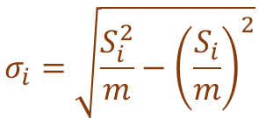
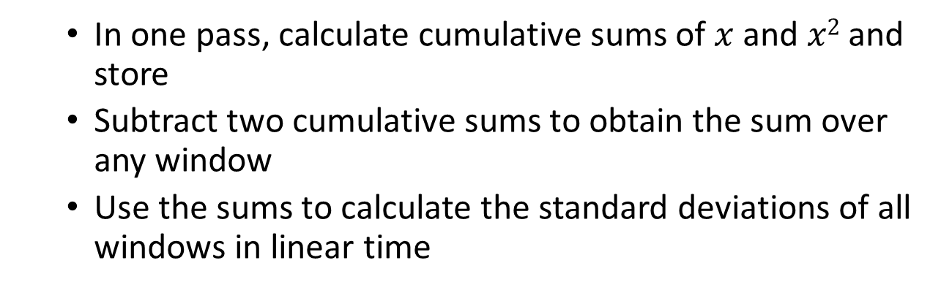
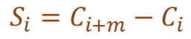
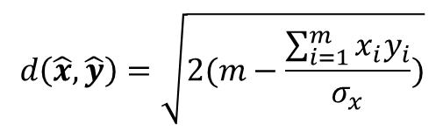
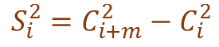
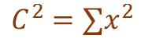
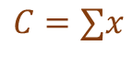
Just-in-time Normalization (2 of 3)
Can we skip the z-normalization scan in each iteration?
The standard deviations of moving windows of a fixed size can be calculated in one linear scan.
In 2016, MATLAB has introduced a function, movstd, that does the above.
$$d\left(\hat{x},\hat{y}\right)=\sqrt{2(m−\frac{\sum_{i=1}^{m}{x_{i}y_{i}}}{σ_{x}})}$$
In one pass, calculate cumulative sums of $x$ and $x2$ and store
Subtract two cumulative sums to obtain the sum over any window
Use the sums to calculate the standard deviations of all windows in linear time
$$C=∑x$$
$$C^{2}=∑x^{2}$$
$$S_{i}=C_{i+m}−C_{i}$$
$$S_{i}^{2}=C_{i+m}^{2}−C_{i}^{2}$$
$$σ_{i}=\sqrt{{\frac{S_{i}^{2}}{m}−\left(\frac{S_{i}}{m}\right)}^{2}}$$
Thanawin Rakthanmanon, et al. Searching and mining trillions of time series subsequences under dynamic time warping. KDD 2012: 262-270

Slide 18
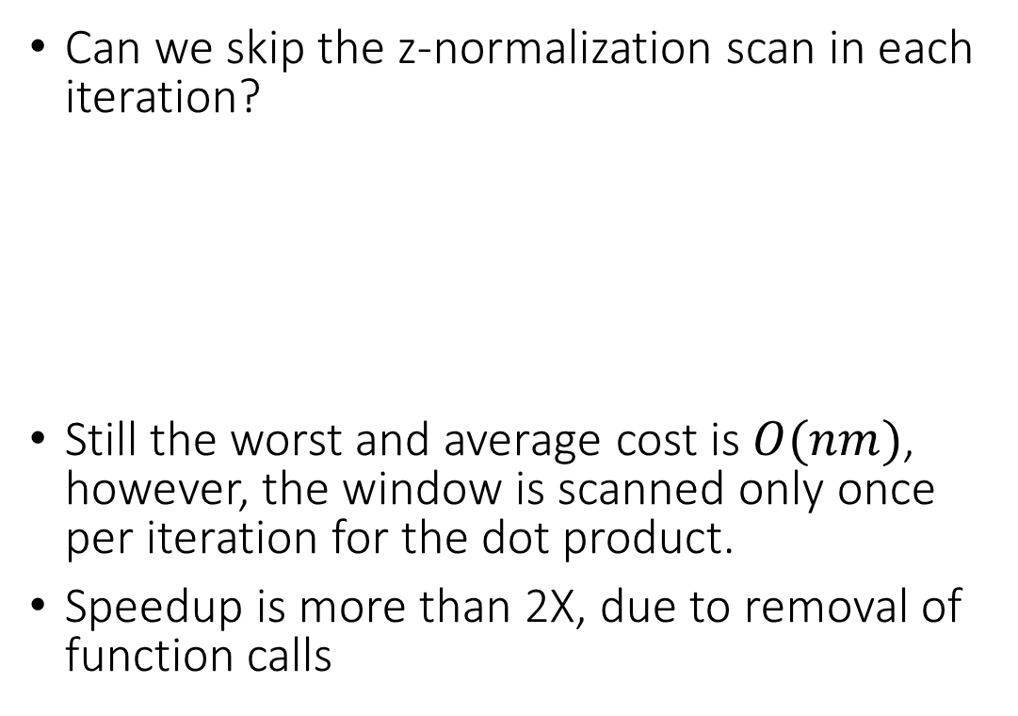
Just-in-time Normalization (3 of 3)
2¹²
$$m = 100$$
Can we skip the z-normalization scan in each iteration?
Still the worst and average cost is $O(nm)$, however, the window is scanned only once per iteration for the dot product.
Speedup is more than 2X, due to removal of function calls
2⁸
BF
d(1:n) = 0;
Q = zNorm(query);
S = movstd(T,[0 m-1]);
for i = 1:n-m+1
d(i) = sqrt(2*(m-sum(T(i:i+m-1).*Q)/S(i)));
end
2⁴
JIT Norm
Seconds
2⁰
2⁻⁴
2⁻⁸
10⁵
10⁶
n
10⁷
10⁸
Thanawin Rakthanmanon, et al. Searching and mining trillions of time series subsequences under dynamic time warping. KDD 2012: 262-270

Slide 19
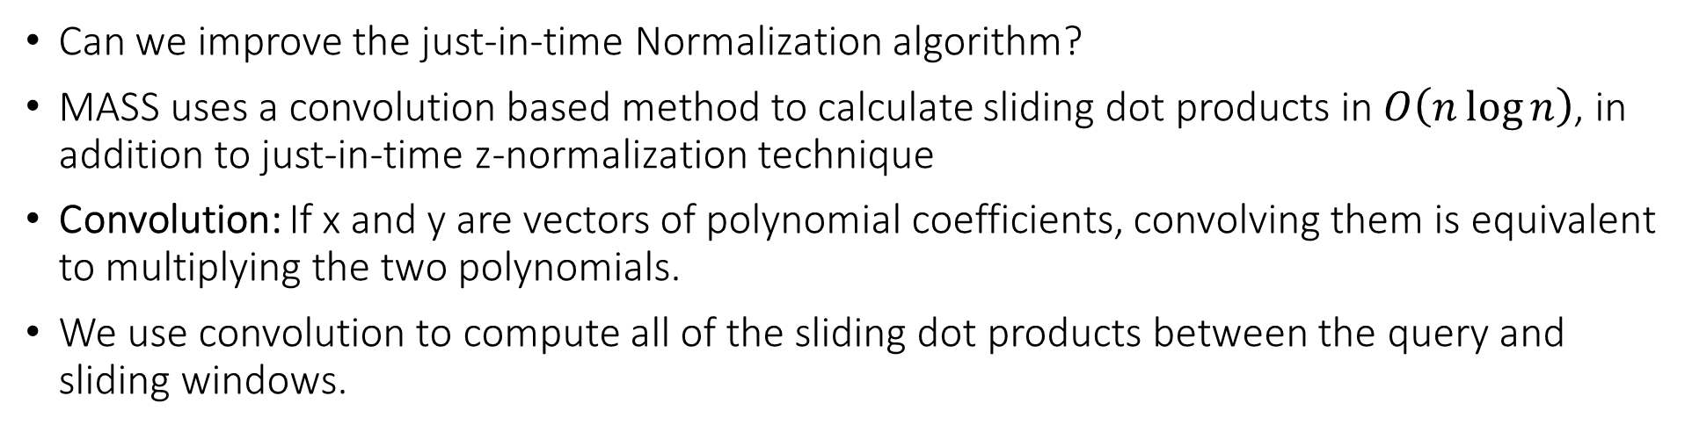
Mueen’s Algorithm for Similarity Search (MASS) (1 of 9)
Can we improve the just-in-time Normalization algorithm?
MASS uses a convolution based method to calculate sliding dot products in $O\left(n\log{n}\right)$, in addition to just-in-time z-normalization technique
Convolution: If x and y are vectors of polynomial coefficients, convolving them is equivalent to multiplying the two polynomials.
We use convolution to compute all of the sliding dot products between the query and sliding windows.
x₁
x₂
x₃
x₄
y₁
y₂
Input
Time Series
Reversed and Padded Query
x₁
x₂
x₃
x₄
y₂
y₁
0
0
Convolution
y₂x₁
y₂x₂+y₁x₁
y₂x₃+y₁x₂
y₂x₄+y₁x₃
y₁x₄
0
0
Output
y₂x₂+y₁x₁
y₂x₃+y₁x₂
y₂x₄+y₁x₃

Slide 20
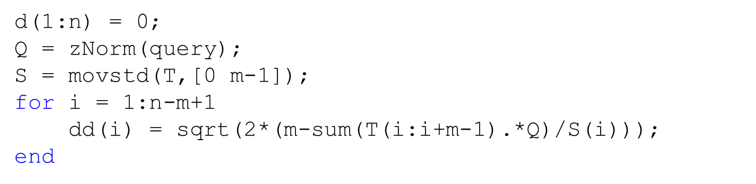
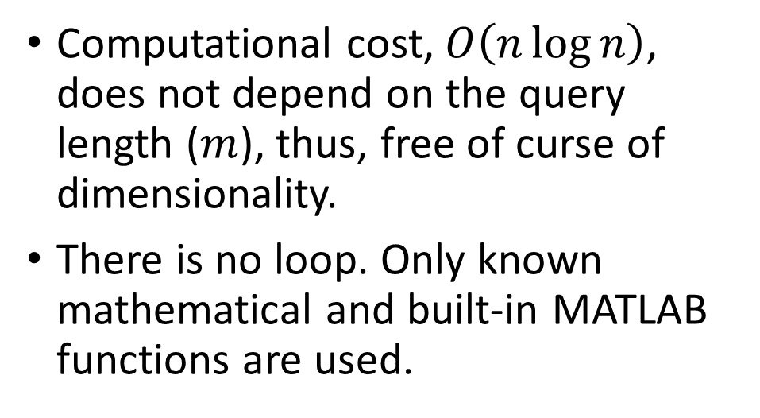
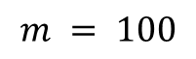
Mueen’s Algorithm for Similarity Search (MASS) (2 of 9)
d(1:n) = 0;
Q = zNorm(query);
Stdv = movstd(T,[0 m-1]);
Q = Q(end:-1:1); %Reverse the query
Q(m+1:n) = 0; %pad zeros
dots = conv(T,Q);
dist = 2*(m-(dots(m:n))./Stdv));
dist = sqrt(dist);
The loop has been replaced by the following three lines.
MASS
1.0
Vectorized working formula
2¹²
$$m = 100$$
Computational cost, $O\left(n\log{n}\right)$, does not depend on the query length ($m$), thus, free of curse of dimensionality.
There is no loop. Only known mathematical and built-in MATLAB functions are used.
2⁸
BF
2⁴
Seconds
JIT Norm
MASS 1.0
2⁰
2⁻⁴
2⁻⁸
10⁵
10⁶
n
10⁷
10⁸
http://www.cs.unm.edu/~mueen/FastestSimilaritySearch.html

Slide 21
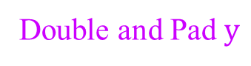
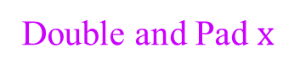
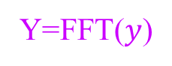
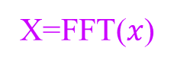
Mueen’s Algorithm for Similarity Search (MASS) (3 of 9)
Can we improve MASS 1.0?
Note that convolution doubles the size of the input vectors in the output.
MASS uses only half of the output of convolution and throws away the remaining half.
Can we compute just the necessary half? Let’s see what happens inside convolution.
Convolution in time domain is multiplication in frequency domain.
conv(x,y) = ifft( fft( double&pad(x)) . fft(double&pad(y))
Double and Pad $x$
Double and Pad $y$
x₁
x₂
x₃
x₄
0
0
0
0
y₂
y₁
0
0
0
0
0
0
X=FFT($x$)
Y=FFT($y$)
X₁
X₂
X₃
X₄
X₅
X₄*
X₃*
X₂*
Y₁
Y₂
Y₃
Y₄
Y₅
Y₄*
Y₃*
Y₂*
X.Y
Complex
Conjugates
Y₁X₁
Y₂X₂
Y₃X₃
Y₄X₄
Y₅X₅
Y₄*X₄*
Y₃*X₃*
Y₂*X₂*
ifft(X.Y)
y₂x₁
y₂x₂+y₁x₁
y₂x₃+y₁x₂
y₂x₄+y₁x₃
y₁x₄
0
0

Slide 22
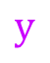

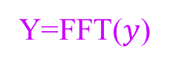
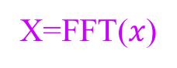
Mueen’s Algorithm for Similarity Search (MASS) (4 of 9)
Can we improve MASS 1.0?
If we do not double x and y, we obtain a half convolution
half conv(x,y)= ifft ( fft(x) . fft(y))
Double and Pad $x$
Double and Pad $y$
$$x$$
$$y$$
x₁
x₂
x₃
x₄
0
0
0
0
y₂
y₁
0
0
0
0
0
0
x₁
x₂
x₃
x₄
y₂
y₁
0
0
X=FFT($x$)
Y=FFT($y$)
X=FFT($x$)
Y=FFT($y$)
X₁
X₂
X₃
X₄
X₅
X₂*
Y₁
Y₂
Y₃
Y₄
Y₅
X₁
X₂
X₃
X₂*
Y₁
Y₂
Y₃
Y₂*
X₄*
X₃*
Y₄*
Y₃*
Y₂*
X.Y
Complex
Conjugates
X.Y
Y₁X₁
Y₂X₂
Y₃X₃
Y₄X₄
Y₅X₅
Y₁X₁
Y₂X₂
Y₃*X₃*
Y₂*X₂*
Y₄*X₄*
Y₃*X₃*
Y₂*X₂*
ifft(X.Y)
ifft(X.Y)
y₂x₁
y₂x₂+y₁x₁
y₂x₃+y₁x₂
y₂x₄+y₁x₃
y₁x₄
0
0
y₂x₁
y₂x₂+y₁x₁
y₂x₃+y₁x₂
y₂x₄+y₁x₃
conv(x,y) = ifft( fft( double&pad(x)) . fft(double&pad(y) )
half conv(x,y)= ifft ( fft(x) . fft(y))

Slide 23
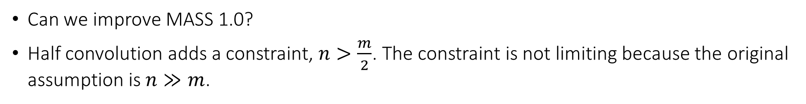
Mueen’s Algorithm for Similarity Search (MASS) (5 of 9)
Can we improve MASS 1.0?
Half convolution adds a constraint, $n>\frac{m}{2}$. The constraint is not limiting because the original assumption is $n≫m$.
x₁
x₂
x₃
x₄
y₁
y₂
x₁
x₂
x₃
x₄
y₁
y₂
Reversed and
Padded Query
Time Series
Reversed and Padded Query
Time Series
x₁
x₂
x₃
x₄
y₂
y₁
0
0
x₁
x₂
x₃
x₄
y₂
y₁
0
0
y₂x₁
y₂x₂+y₁x₁
y₂x₃+y₁x₂
y₂x₄+y₁x₃
y₁x₄
0
0
y₂x₁
y₂x₂+y₁x₁
y₂x₃+y₁x₂
y₂x₄+y₁x₃
conv(x,y) = ifft( fft( double&pad(x)) . fft(double&pad(y) )
half conv(x,y)= ifft ( fft(x) . fft(y))

Slide 24
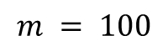
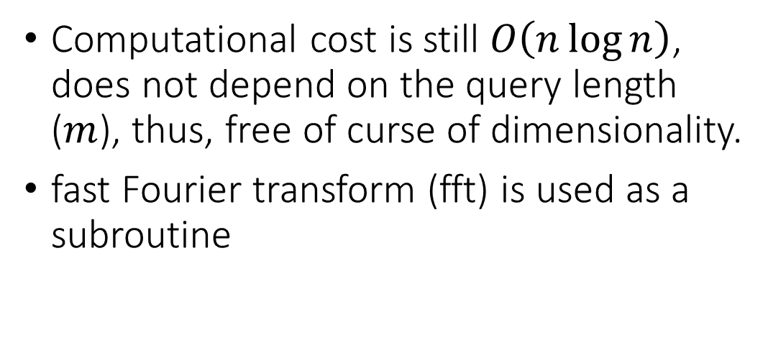
Mueen’s Algorithm for Similarity Search (MASS) (6 of 9)
d(1:n) = 0;
Q = zNorm(query);
Stdv = movstd(T,[0 m-1]);
Q = Q(end:-1:1); %Reverse the query
Q(m+1:n) = 0; %pad zeros
dots = ifft( fft(T).* fft(Q) );
dist = 2*(m-(dots(m:n))./Stdv));
dist = sqrt(dist);
MASS
2.0
The conv(T,Q) has been replaced, no doubling of sizes
2¹²
Computational cost is still $O\left(n\log{n}\right)$, does not depend on the query length ($m$), thus, free of curse of dimensionality.
fast Fourier transform (fft) is used as a subroutine
$$m = 100$$
2⁸
BF
2⁴
MASS 2.0
Seconds
JIT Norm
MASS 1.0
2⁰
2⁻⁴
2⁻⁸
10⁵
10⁶
n
10⁷
10⁸

Slide 25
Mueen’s Algorithm for Similarity Search (MASS) (7 of 9)
Can we improve MASS 2.0?
This idea is a rediscovery of a known result, Overlap-add, Overlap-save [a]
Instead of processing all n samples at once, we can (carefully) process them piecewise, where sizes of the pieces are powers of two.
The pieces must overlap exactly m-1 samples to preserve continuity of the distance profile.
The last piece can be of size that is not a power of two.
K-m+1
0.2
K
n = 1,000,000
m = 100
0.18
0.16
m-1
L
Seconds
0.14
0.12
Hardware dependent minima
0.1
0.08
2¹⁰
2¹¹
2¹²
2¹³
2¹⁴
2¹⁵
2¹⁶
2¹⁷
2¹⁸
[a] https://en.wikipedia.org/wiki/Overlap%E2%80%93add_method
[b] https://users.ece.cmu.edu/~franzf/papers/gttse07.pdf
Size (K)
65,536

Slide 26
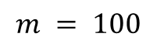
Mueen’s Algorithm for Similarity Search (MASS) (8 of 9)
2¹²
$$m = 100$$
2⁸
BF
2⁴
Seconds
JIT Norm
MASS 2.0
MASS 1.0
MASS 3.0
2⁰
2⁻⁴
2⁻⁸
10⁵
10⁶
n
10⁷
10⁸

Slide 27
Mueen’s Algorithm for Similarity Search (MASS) (9 of 9)
2¹²
Design a new application specific processor to do FFT efficiently [a][b].
Keep the general processor and optimize DRAM to compute FFT efficiently [c].
Keep a commodity box, add a GPU to do FFT efficiently [d].
Keep a commodity box, add an FPGA to do FFT efficiently [e].
Take a commodity box, and use sparse FFT [f].
2⁸
BF
2⁴
Seconds
JIT Norm
MASS 2.0
MASS 1.0
MASS 3.0
2⁰
[a] The Fast Fourier Transform in Hardware: A Tutorial Based on an FPGA Implementation, George Slade.
[b] Appendix C: Efficient Hardware Implementations of FFT Engines, Nasserbakht, Mitra (Ed. Bingham, John A. C.) ADSL, VDSL, and Multicarrier Modulation, John Wiley & Sons, Inc. 2001
[c] B. Akın, F. Franchetti and J. C. Hoe, "Understanding the design space of DRAM-optimized hardware FFT accelerators," 2014 IEEE 25th International Conference on Application-Specific Systems, Architectures and Processors, Zurich, 2014, pp. 248-255.
[d] Naga K. Govindaraju, Brandon Lloyd, Yuri Dotsenko, Burton Smith, and John Manferdelli. 2008. High performance discrete Fourier transforms on graphics processors. In Proceedings of the 2008 ACM/IEEE conference on Supercomputing (SC '08).
[e] Ren Chen, Shreyas G. Singapura, and Viktor K. Prasanna. 2017. Optimal dynamic data layouts for 2D FFT on 3D memory integrated FPGA. J. Supercomput. 73, 2 (February 2017), 652-663.
[f] Haitham Hassanieh, Piotr Indyk, Dina Katabi, and Eric Price. 2012. Simple and practical algorithm for sparse Fourier transform. In Proceedings of the twenty-third annual ACM-SIAM symposium on Discrete algorithms (SODA '12). 1183-1194.
2⁻⁴
2⁻⁸
10⁵
10⁶
n
10⁷
10⁸

Slide 28
Numerical Errors in MASS
Three possible sources of numerical errors in MASS
Convolution
Numerical error in Convolution can appear if n is very large, MASS 3.0 reduces such error by dividing the computation in batches
Division by the standard deviation
If a subsequence is constant, the standard deviation is zero, causing divide by zero errors. MASS reduces such error by checking the standard deviations ahead of the division.
Square root of the distances
Theoretically it is not possible to have negative squared distance. However, for exact matches, the squared distance can be a very small negative number (-1.09e-15), resulting imaginary numbers in the output.
d(1:n) = 0;
Q = zNorm(query);
Stdv = movstd(T,[0 m-1]);
Q = Q(end:-1:1);
Q(m+1:n) = 0;
dots = ifft( fft(T).* fft(Q) );
dist = 2*(m-(dots(m:n))./Stdv));
dist = sqrt(dist);

Slide 29
Outline
Act 1
Act 2
Our Fundamental Assumption
What is the (MP) Matrix Profile?
Properties of the MP
Developing a Visual Intuition for MP
Basic Algorithms
MP Motif Discovery
MP Time Series Chains
MP Anomaly Discovery
MP Joins (self and AB)
MP Semantic Segmentation
From Domain Agnostic to Domain Aware: The Annotation Vector (A simple way to use domain knowledge to adjust your results)
The “Matrix Profile and ten lines of code is all you need” philosophy.
Break
Background on time series mining
Similarity Measures
Normalization
Distance Profile
Brute Force Approach
Just-in-time Normalization
The MASS Algorithm
Extensions of MASS
Matrix Profile
STAMP
STOMP
GPU-STOMP
SCRIMP
Open problems to solve
Rest Zone

Slide 30

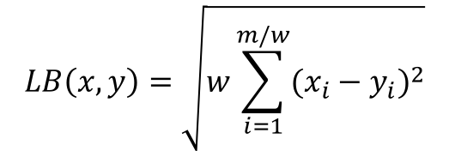
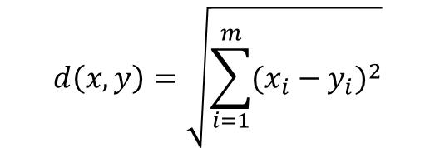
MASS Extensions: Approximate Distance Profile
Can we trade speed with accuracy in MASS?
We use piecewise aggregate approximation (PAA) to reduce dimensionality of both T and Q
sqrt(w)* MASS(PAA(T,w),PAA(Q,w),m/w)
w = 2
PAA
w = 4
w = 8
$$w$$
1
2
3
4
5
6
7
$$LB\left(x,y\right)=\sqrt{w\sum_{i=1}^{m/w}{{(x_{i}−y_{i})}^{2}}}$$
$$d\left(x,y\right)=\sqrt{\sum_{i=1}^{m}{{(x_{i}−y_{i})}^{2}}}$$
Approximate distance profile in Red
Selina Chu, Eamonn J. Keogh, David M. Hart, Michael J. Pazzani: Iterative Deepening Dynamic Time Warping for Time Series. SDM 2002: 195-212

Slide 31
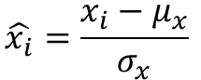
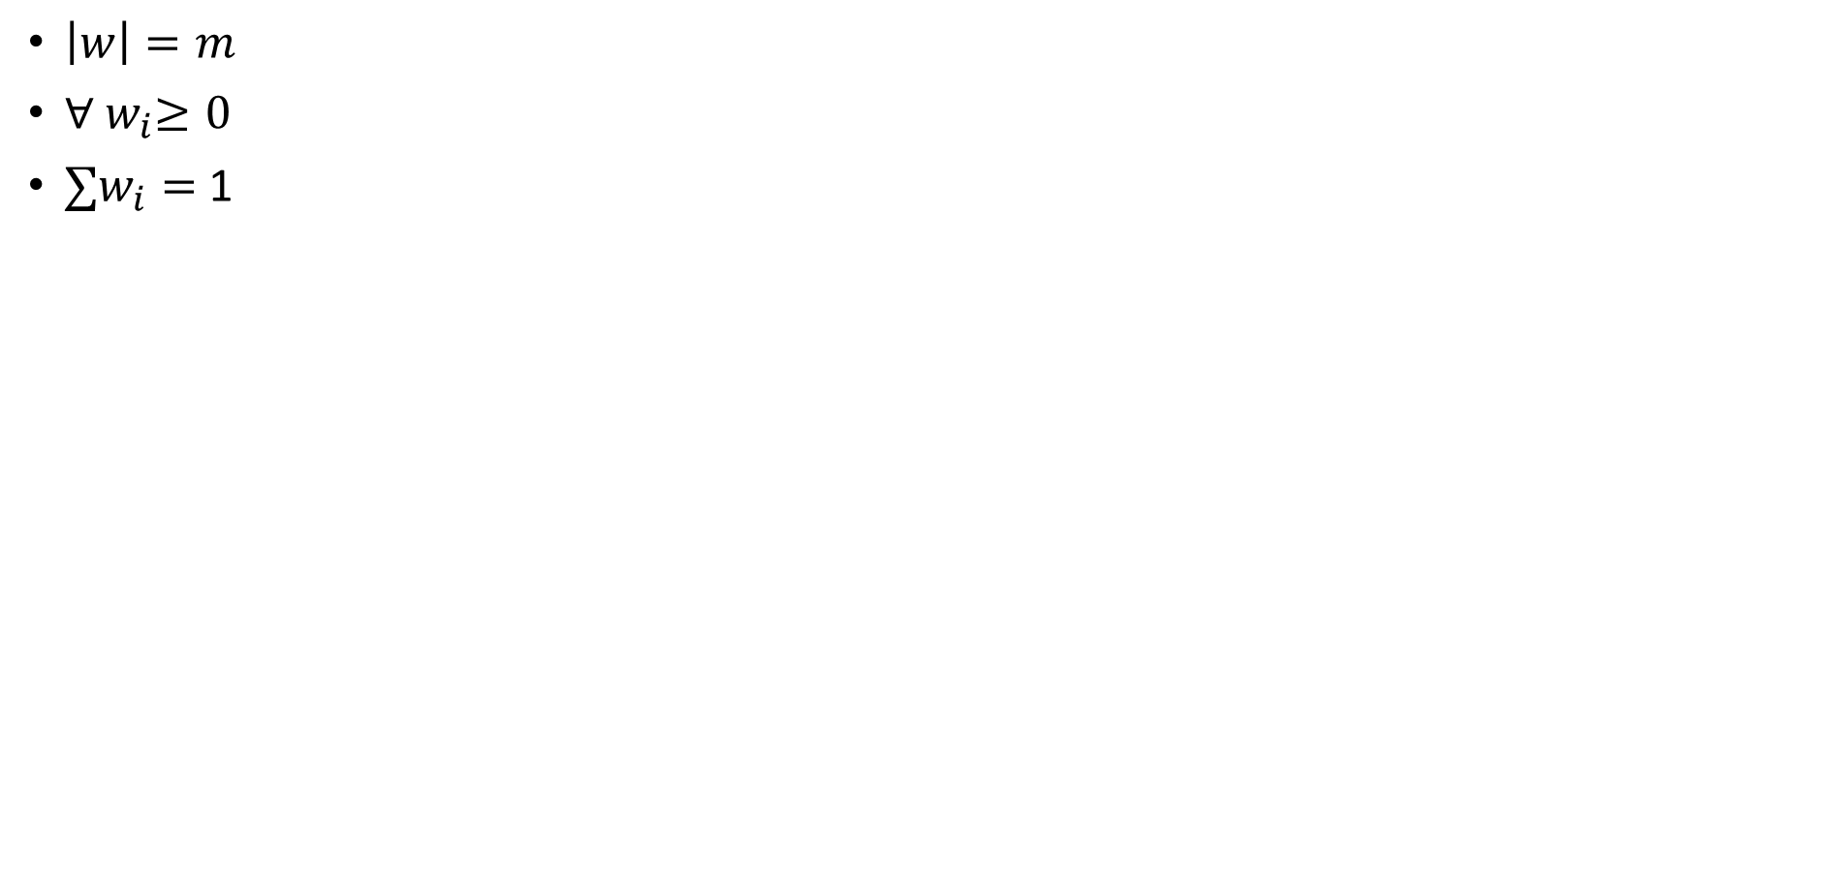
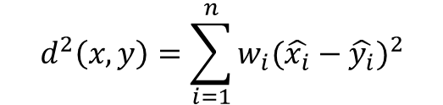
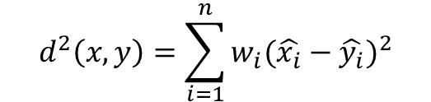
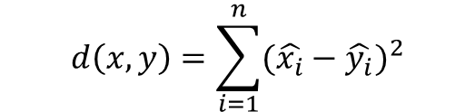
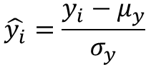
MASS Extensions: Weighted Query
Given two time series
x = x₁…x_{n}
and
y = y₁…y_{n}
their z-Normalized weighted Euclidean distance is defined as:
$$d\left(x,y\right)=\sum_{i=1}^{n}{{(\hat{x_{i}}−\hat{y_{i}})}^{2}}$$
$$d^{2}\left(x,y\right)=\sum_{i=1}^{n}{w_{i}{(\hat{x_{i}}−\hat{y_{i}})}^{2}}$$
w
$$\hat{x_{i}}=\frac{x_{i}−μ_{x}}{σ_{x}}$$
$$\hat{y_{i}}=\frac{y_{i}−μ_{y}}{σ_{y}}$$
$\left|w\right|=m$
${∀ w}_{i}≥0$
${∑w}_{i}=$ 1
$$d^{2}\left(x,y\right)=\sum_{i=1}^{n}{w_{i}{(\hat{x_{i}}−\hat{y_{i}})}^{2}}$$

Slide 32

MASS Extensions: Weighted Query
Working formula that we have been using so far, will not work anymore.
The new working formula is below.
We need three sliding dot products instead of one in regular MASS
$$d^{2}\left(x,y\right)=\sum_{i=1}^{n}{w_{i}{(\hat{x_{i}}−\hat{y_{i}})}^{2}}=\sum_{i=1}^{n}{w_{i}{(\frac{x_{i}−μ_{x}}{σ_{x}}−\hat{y_{i}})}^{2}}=\sum_{i=1}^{n}{w_{i}x_{i}^{2}−2μ_{x}{w_{i}x}_{i}−2{w_{i}x}_{i}}\hat{y_{i}}+μ_{x}^{2}w_{i}−2μ_{x}w_{i}\hat{y_{i}}+w_{i}{\hat{y_{i}}}^{2}$$
Terms with x need
sliding dot products
Terms without x are precomputed

Slide 33
MASS Extensions: Weighted Query Example
15
10
5
0
2.65
2.7
2.75
2.8
2.85
2.9
2.95
3
3.05
Hot Water Usage of a House in Minutes
10⁵
Regular Matches
Wash Cycles
Rinse Cycles
0
5
10
15
20
25
30
35
40
45
0
5
10
15
20
25
30
35
40
Washer
Additional Cycles
Weight Vector
Extended
Wash Cycles

Slide 34
MASS Extensions: Query with Gap(s)
query
We may wish to consider a more general type of query. Queries with gaps, as in the purple example.
I want the first third to slope down, and the last third to slope up with the plateau at the end. However, I don’t care what goes in the middle.
Either of the two red patterns would be acceptable matches.
Note that the relative offset and scaling of the two parts do not matter, and we should be invariant to them. In other words, the exact slope does not matter in the above query statement.
0
50
100
150
200
250
300
0
100
200
300

Slide 35
MASS Extensions: Query with Gap(s)
L
query_{sub2}
Measure the distance between beginning of the two patterns, call it L
Compute…
Dist_profile1 = MASS(T, query_{sub1});
Dist_profile2 = MSAS(T, query_{sub2});
Pad the end of Dist_profile1 and the beginning of Dist_profile2 with a vector of L infinities to add a lag of L
For example, if L = 5, then use {inf, inf, inf, inf, inf}
Create Dist_profile3 = Dist_profile1 + Dist_profile2
We can now use Dist_profile3 to find the nearest neighbor(s) as before.
query_{sub1}
0
100
200
300

Slide 36
MASS Extensions: Query with Gap(s)
Random walk
Padded by L infs or NaNs
Dist_profile1 = MASS(tag, query_{sub1});
Slide by L slots
9116
Dist_profile2 = MASS(tag, query_{sub2});
1336
Dist_profile3 = Dist_profile1 + Dist_profile2
Min value is at 1536
Note that for the best match, each part of the query scaled differently.
For the image to the right, I fixed the left side and scaled the right side (to give context), but both sides needed rescaling somewhat
query_{sub1}
query_{sub2}
0
100
200
300

Slide 37
Outline
Act 1
Act 2
Our Fundamental Assumption
What is the (MP) Matrix Profile?
Properties of the MP
Developing a Visual Intuition for MP
Basic Algorithms
MP Motif Discovery
MP Time Series Chains
MP Anomaly Discovery
MP Joins (self and AB)
MP Semantic Segmentation
From Domain Agnostic to Domain Aware: The Annotation Vector (A simple way to use domain knowledge to adjust your results)
The “Matrix Profile and ten lines of code is all you need” philosophy.
Break
Background on time series mining
Similarity Measures
Normalization
Distance Profile
Brute Force Approach
Just-in-time Normalization
The MASS Algorithm
Extensions of MASS
Matrix Profile
STAMP
STOMP
GPU-STOMP
SCRIMP
Open problems to solve

Slide 38
Matrix Profile from Distance Profiles
Query, the 1st subsequence in the time series
Obtain the z-normalized Euclidean distance between Query and each window (subsequence) in the time series. We would obtain a vector like this:
d_{1,1}(= 0) | d_{2,1} | … | d_{n-m+1,1}
D₁
d_{i,j} is the distance between the i^{th} subsequence and the j^{th} subsequence.
We can obtain D₂, D₃, … D_{n-m+1} similarly.

Slide 39
Matrix Profile from Distance Profiles
j^{th}
The distance matrix is symmetric
The diagonal is zero
Cells close to the diagonal are very small
d_{1,1} | d_{1,2} | … | … | … | d_{1,n-m+1}
d_{2,1} | d_{2,2} | … | … | … | d_{2,n-m+1}
… | … | … | … | … | …
d_{i,1} | d_{i,2} | … | d_{i,j} | … | d_{i,n-m+1}
… | … | … | … | … | …
d_{n-m+1,1} | d_{n-m+1,2} | … | … | … | d_{n-m+1,n-m+1}
D₁
D₂
D_{i}
D_{n-m+1}
i^{th}
d_{i,j} is the distance between the i^{th} window and the j^{th} window of the time series
Min(D₁)
Min(D₂)
Min(D_{i})
Min(D_{n-m+1})
P₁ | P₂ | … | … | ... | P_{n-m+1}
Matrix Profile: a vector of distance between each subsequence and its nearest neighbor

Slide 40
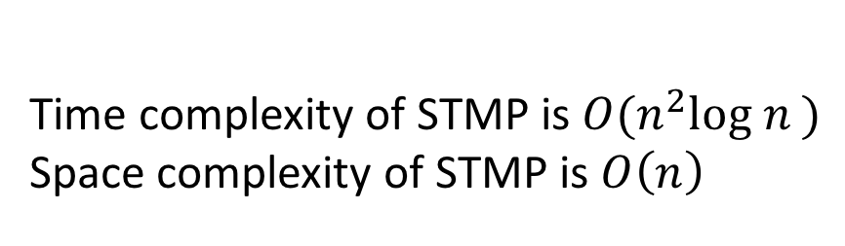
STMP: Scalable Time Series Matrix Profile Algorithm
j^{th}
d_{1,1} | d_{1,2} | … | … | … | d_{1,n-m+1}
d_{2,1} | d_{2,2} | … | … | … | d_{2,n-m+1}
… | … | … | … | … | …
d_{i,1} | d_{i,2} | … | d_{i,j} | … | d_{i,n-m+1}
… | … | … | … | … | …
d_{n-m+1,1} | d_{n-m+1,2} | … | … | … | d_{n-m+1,n-m+1}
D₁
D₂
D_{i}
D_{n-m+1}
MP(1:n-m+1) = inf;
for i = 1:n-m+1
d = MASS(T,T(i:i+m-1));
MP = min([MP ; d]);
end
i^{th}
Min(D₁)
Min(D₂)
Min(D_{i})
Min(D_{n-m+1})
P₁ | P₂ | … | … | ... | P_{n-m+1}
Time complexity of STMP is $O(n^{2}log n )$
Space complexity of STMP is $O\left(n\right)$
Matrix Profile: a vector of distance between each subsequence and its nearest neighbor

Slide 41
Matrix Profile Index
MP(1:n-m+1) = inf;
MPI(1:n-m+1) = -1;
for i = 1:n-m+1 in a random order
d = MASS(T,T(i:i+m-1));
[MP, ind] = min([MP ; d]);
MPI(ind==2) = i;
end
Matrix Profile Index (MPI) can be maintained as we compute the profile
Vectorized min functions can be used to efficiently maintain MPI
Overhead is negligible
Assumes MP and d as column vectors

Slide 42
Trivial Match I
We need to understand the idea of a “trivial match”. It shows up for definitions of discords, motifs, similarity search etc.
Suppose we search for the query, of length 20, in the time series…
…we find its best match is at location 50…
Query Q
Time Series T
0
20
40
60
80
100
120
140
160
Best Match

Slide 43
Trivial Match II
Where is the second best match? It is probably going to be at 49 or 51, but that is trivial, it is just a minor “variant” of the original match.
(try togging backwards and forwards between this and the last slide)
Query Q
Time Series T
0
20
40
60
80
100
120
140
160
Second Best Match

Slide 44
Trivial Match III
To avoid trivial matches, we find the first match, then we set an exclusion zone around the best match, then find the second best match, etc.
The size of the exclusion zone is not critical, ½ m works well.
Query Q
Time Series T
0
20
40
60
80
100
120
140
160
Best Match
(Non-Trivial) Second Best Match

Slide 45
Trivial Match IIII Special Case
When computing the MP, we will be extracting the subsequences from the time series itself.
Clearly such queries will just find “themselves” as their own nearest neighbor!
The distance from the query to any part of the subsequence that overlaps the exclusion zone is kept undefined (NaN).
Query Q
Time Series T
0
20
40
60
80
100
120
140
160
Location Query was taken from
(Non-Trivial) Best Match

Slide 46
STMP: Scalable Time Series Matrix Profile Algorithm
MP(1:n-m+1) = inf;
MPI(1:n-m+1) = -1;
for i = 1:n-m+1
d = MASS(T,T(i:i+m-1));
d( max(i-m/4,1) : min(i+m/4-1,n-m+1))= NaN;
[MP, ind] = min([MP ; d]);
MPI(ind==2) = i;
end
d_{1,1} | d_{1,2} | … | … | … | d_{1,n-m+1}
d_{2,1} | d_{2,2} | … | … | … | d_{2,n-m+1}
… | … | … | … | … | …
d_{i,1} | d_{i,2} | … | d_{i,j} | … | d_{i,n-m+1}
… | … | … | … | … | …
d_{n-m+1,1} | d_{n-m+1,2} | … | … | … | d_{n-m+1,n-m+1}
Size of Exclusion Zone depends on the smoothness of the time series. A default value of m/2 works well.
Data adaptive heuristic could be to set the length of the exclusion zone equal to m or the period (1/f) of the highest energy frequency, whichever is smaller.
Min(D₁)
Min(D₂)
Min(D_{i})
Min(D_{n-m+1})
P₁ | P₂ | … | … | ... | P_{n-m+1}

Slide 47
STAMP: Scalable Time Series Anytime Matrix Profile
Each distance profile is independent of other distance profiles, the order in which we compute them can be random
A random ordering averages the performance over properties of the time series, such as smoothness, frequency, stationarity, etc.
The random ordering provides diminishing return, which allows interrupt-resume operations anytime.
MP(1:n-m+1) = inf;
MPI(1:n-m+1) = -1;
for i = 1:n-m+1 in a random order
d = MASS(T,T(i:i+m-1));
d( max(i-m/4,1) : min(i+m/4-1,n-m+1))= NaN;
[MP, ind] = min([MP ; d]);
MPI(ind==2) = i;
end

Slide 48
Exploring the Anytime Property (1 of 3)
approximate matrix profile at 1,000 iterations.
RMSE between the MP and the approximate MP
exact matrix profile
0
1,000
iteration
10,000
The approximate matrix profile at 1,000 iteration is extremely similar to the exact solution.
The convergence rate increases, for larger datasets.

Slide 49

Exploring the Anytime Property (2 of 3)
Play Video

Slide 50


Exploring the Anytime Property (3 of 3)
After doing only 1/500th of the computations, the basic shape of the MP has converged, and we have found the final correct motif.
As an aside, note that the dimensionality of the subsequences here is 60,000.

Slide 51

STOMP: Scalable Time series Ordered Matrix Profile
Can we improve STAMP? STAMP computes distance profiles for rows in random order. Each distance profile is computed independently. However, the successive rows are profiles of two queries that overlap in $m−1$ observations. We can exploit the overlap between successive queries while computing their distance profiles to build an $O(n2)$time, $O(n)$ space algorithm.
d_{1,1} | d_{1,2} | … | … | … | d_{1,n-m+1}
d_{2,1} | d_{2,2} | … | … | … | d_{2,n-m+1}
… | … | … | … | … | …
d_{i,1} | d_{i,2} | … | d_{i,j} | … | d_{i,n-m+1}
… | … | … | … | … | …
d_{n-m+1,1} | d_{n-m+1,2} | … | … | … | d_{n-m+1,n-m+1}
Min(D₁)
Min(D₂)
Min(D_{i})
Min(D_{n-m+1})
P₁ | P₂ | … | … | ... | P_{n-m+1}

Slide 52



STOMP: Scalable Time series Ordered Matrix Profile
We have an O(n²) time, O(n) space algorithm called STOMP to evaluate it.
Recall our working formula:
$$T_{i}T_{j}=\sum_{k=0}^{m−1}{t_{i+k}t_{j+k}}$$
Dot product of the i^{th} window and the j^{th} window.
$$d_{i,j}=\sqrt{2m\left(1−\frac{T_{i}T_{j}−mμ_{i}μ_{j}}{mσ_{i}σ_{j}}\right)}$$
We precompute and store the means and standard deviations in O(n) space and time using the movmean and movstd functions.
Once we know$T_{i}T_{j}$, it takes O(1) time to compute $d_{i,j}$

Slide 53




















The relationship between $T_{i}T_{j}$and${ T}_{i+1}T_{j+1}$
… | $$t_{i}$$ | $$t_{i+1}$$ | $$t_{i+2}$$ | … | $$t_{i+m−1}$$ | $$t_{i+m}$$ | …
$$T_{i}T_{j}=\sum_{k=0}^{m−1}{t_{i+k}t_{j+k}}$$
…
$$×$$
$$+$$
$$×$$
$$+$$
$$×$$
$$+$$
$$+$$
$$×$$
… | $$t_{j}$$ | $$t_{j+1}$$ | $$t_{j+2}$$ | … | $$t_{j+m−1}$$ | $$t_{j+m}$$ | …
… | $$t_{i}$$ | $$t_{i+1}$$ | $$t_{i+2}$$ | … | $$t_{i+m−1}$$ | $$t_{i+m}$$ | …
$T_{i+1}T_{j+1}=$
$$×$$
$$+$$
$$×$$
$$+$$
$$+$$
$$×$$
$$+$$
$$×$$
… | $$t_{j}$$ | $$t_{j+1}$$ | $$t_{j+2}$$ | … | $$t_{j+m−1}$$ | $$t_{j+m}$$ | …
$$T_{i+1}T_{j+1}\text{= }T_{i}T_{j}−t_{i}t_{j}+t_{i+m}t_{j+m}$$
$O\left(1\right)$ time complexity

Slide 54





STOMP Algorithm: Computing the i^{th} Row
All means and standard deviations are precomputed. This costs linear time and space.
The first column and row of the matrix are identical and pre-computed by MASS.
We iterate through the rows. The previous row is maintained as a local array to feed dot products.
The dot products are converted to distance values and compared against the current best in the profile.
$$μ_{1}$$ | $$μ_{2}$$ | $$μ_{3}$$ | … | $$μ_{n−m+1}$$
$$σ_{1}$$ | $$σ_{2}$$ | $$σ_{3}$$ | … | $$σ_{n−m+1}$$
$$T_{1}T_{1}$$
$$T_{2}T_{1}$$
. . .
$$T_{i−1}T_{1}$$
$$T_{i}T_{1}$$
. . .
$$T_{n−m}T_{1}$$
$$T_{n−m+1}T_{1}$$
$$T_{1}T_{2}$$ | $$T_{1}T_{3}$$ | … | $$T_{1}T_{n−m}$$ | $$T_{1}T_{n−m+1}$$
Precomputed Arrays
$$T_{i−1}T_{2}$$ | $$T_{i−1}T_{3}$$ | … | $$T_{i−1}T_{n−m}$$ | $$T_{i−1}T_{n−m+1}$$
$$T_{i}T_{2}$$ | $$T_{i}T_{3}$$ | … | $$T_{i}T_{n−m}$$ | $$T_{i}T_{n−m+1}$$
Rolling Arrays
Update if Smaller
Output Arrays
P₁ | P₂ | P₃ | … | P_{n-m+1}
I₁ | I₂ | I₃ | … | I_{n-m+1}

Slide 55





SCRIMP: Scalable Column Independent Matrix Profile
Precomputed Arrays
$$μ_{1}$$ | $$μ_{2}$$ | $$μ_{3}$$ | … | $$μ_{n−m+1}$$
$$σ_{1}$$ | $$σ_{2}$$ | $$σ_{3}$$ | … | $$σ_{n−m+1}$$
$$T_{1}T_{1}$$
$$T_{2}T_{1}$$
. . .
$$T_{i−1}T_{1}$$
$$T_{i}T_{1}$$
. . .
$$T_{n−m}T_{1}$$
$$T_{n−m+1}T_{1}$$
$$T_{1}T_{2}$$ | $$T_{1}T_{3}$$ | … | $$T_{1}T_{n−m}$$ | $$T_{1}T_{n−m+1}$$
 |  |  |  | $$T_{n−m+1}T_{n−m+1}$$
STOMP iterates through rows. Each row depends on the previous row. Therefore random ordering is not suitable.
However, the diagonals are independent of each other. We exploit this property to randomize the computation so we achieve an anytime $O(n^{2})$ algorithm.
We avoid computing the upper triangle of the matrix because the distance matrix is symmetric.
P₁ | P₂ | P₃ | … | P_{n-m+1}
Output Arrays
I₁ | I₂ | I₃ | … | I_{n-m+1}

Slide 56

Porting STOMP to GPU
Each thread is assigned to calculate one entry in the matrix profile in every iteration.
All the precomputed arrays are in global shared memory that is accessible to all threads.
Threads are synced after a row is processed to avoid race.
We can further optimize to compute only the lower triangle of the matrix, please see the paper.
…

Slide 57
Comparison of STAMP, STOMP and GPU-STOMP
For a fix subsequence length m=256: time
Algorithm n | 2¹⁷ | 2¹⁸ | 2¹⁹ | 2²⁰
STAMP | 15.1 min | 1.17 hours | 5.4 hours | 24.4 hours
STOMP | 4.21 min | 0.3 hours | 1.26 hours | 5.22 hours
GPU-STOMP | 10 sec | 18 sec | 46 sec | 2.5 min
For large data, and for the very first time in the literature, 100,000,000
Algorithm m | n | 2000 | 17,279,800 | 400 | 100,000,000
STAMP (estimated) | 36.5 weeks | 25.5 years
STOMP (estimated) | 8.4 weeks | 5.4 years
GPU-STOMP | 9.27 hours | 12.13 days

Slide 58
Comparing the speed of STOMP with existing algorithms
For a time series of length $2^{18}$: CPU time(memory usage)
Algorithm m | 512 | 1,024 | 2,048 | 4,096
STOMP | 501s (14MB) | 506s (14MB) | 490s (14MB) | 490s (14MB)
Quick-Motif | 27s (65MB) | 151s (90MB) | 630s (295MB) | 695s (101MB)
MK | 2040s (1.1GB) | N/A (>2GB) | N/A (>2GB) | N/A (>2GB)
Note: the time and space cost of STOMP is completely independent of any properties (noise, trends, stationarity etc.) of data.
Quick-Motif and MK are pruning based techniques with non-monotonic space need.
STOMP produces more information (i.e. Matrix Profile) while the others find the motifs only.

Slide 59
The Progress Bar Question: How long will it take for STOMP, SCRIMP to finish?
Given the inputs, the time is completely deterministic.
The time is completely independent of, m the length of the query. So long as m << n.
The time is completely independent of the structure/noise-level of data itself.
As it happens, these properties are very rare in data mining algorithms.
Can we use these properties to estimate time-to-finish?

Slide 60

The Progress Bar Question: How long will it take for STOMP, STAMP or SCRIMP to finish?
The time only depends on the length of the time series, n, and the hardware settings.
To compute the time needed to finish, you just need to do one calibration run on any particular hardware configuration.
$$TimeNeeded =\frac{Time_{calibration}}{n_{calibration}2 } ∗ n_{new}2$$
How well does this work?
We measured the time needed for T = 512, 1024, 2048,… ,131072 (we used an old cheap laptop)
We then used the time measured for the 131,072 run, to predict the time needed for all the other runs.
We plotted the two curves below. Note that the last point agrees by definition.
3500
4
10
3000
3
Red is predicted
10
2500
2
10
2000
1
1500
10
0
1000
Blue is measured
Red is predicted
10
-1
Blue is measured
500
10
-2
0
512
131072
10
512
Note the log axis
131072

Slide 61
Outline
Act 1
Act 2
Our Fundamental Assumption
What is the (MP) Matrix Profile?
Properties of the MP
Developing a Visual Intuition for MP
Basic Algorithms
MP Motif Discovery
MP Time Series Chains
MP Anomaly Discovery
MP Joins (self and AB)
MP Semantic Segmentation
From Domain Agnostic to Domain Aware: The Annotation Vector (A simple way to use domain knowledge to adjust your results)
The “Matrix Profile and ten lines of code is all you need” philosophy.
Break
Background on time series mining
Similarity Measures
Normalization
Distance Profile
Brute Force Approach
Just-in-time Normalization
The MASS Algorithm
Extensions of MASS
Matrix Profile
STAMP
STOMP
GPU-STOMP
SCRIMP
Open problems to solve

Slide 62

Open Problems
Find Lower Bounds
An $O(n)$ lower bound to distance profile
An $O(n log⁡n)$ lower bound to matrix profile
Adapt to L1 distance
$O(n log⁡n)$algorithm for distance profile
$O(n^{2})$algorithm for Matrix Profile
Adapt to DTW distance
Can we create a Matrix Profile of 100M time series under warping?
Variable Length Matrix Profile
Can we rank or sort neighbors of different lengths based on degree of fidelity?
Scalability
Distributed Matrix Profile algorithm for horizontal scalability
Can we exploit hardware acceleration techniques for scalability?

Slide 63

Open Problems
Domain Appropriate Matrix Profile
Recall that both STAMP and SCRIMP converge quickly with random ordering. However, could a data-adaptive ordering converge even faster?
We discussed the Annotation Vector (AV). While we can typically specify an AV with a few lines of code, can we learn a domain appropriate AV from user interaction?
Visualization
At some scale, user-interfaces / user-experience become very important, we have largely glossed over this. Can we develop interactive visualization techniques for active exploration over MP?

Slide 64

Questions?

Slide 65


The End!
Questions?
Visit the Matrix Profile Page
www.cs.ucr.edu/~eamonn/MatrixProfile.html
Visit the MASS Page
www.cs.unm.edu/~mueen/FastestSimilaritySearch.html
Please fill out an evaluation form, available in the back of the room.

